Slide 1

Introduction to React Hooks

Slide 2
Why React Hooks?
Hard to reuse stateful logic between components –
Attaching reusable behaviour to a component
Adoption of patterns like –
Render props, HoC – Higher Order Component
Which leads to –
Restructuring of components
Make our code harder to follow
Wrapper Hell –
Components surrounded by – layers of Providers, Consumers, HoC, Render props and other abstractions

Slide 3
Why React Hooks?
Complex components become hard to understand –
For example –
Data fetching logic in componentDidMount and componentDidUpdate lifecycle methods
Subscription in componentDidMount and unsubscription in componentWillUnmount lifecycle methods
These implementations makes easy to introduce bugs and inconsistencies
In most cases, it’s hard to split these components into smaller ones
Testing become difficult

Slide 4
Why React Hooks?
That’s why we use some third party state management libraries like Redux
But again –
These libraries introduces too much abstraction making developers –
Jump between different files
Reusing components become difficult

Slide 5
Why React Hooks?
Classes confuse both people and machine –
Makes difficult to developers learning React
Good understanding of “this” in JavaScript as it behaves differently in other languages
For example –
Developers need to remember to bind the event handlers
Most importantly, understand when to use class component and when to use function component
May lead to disagreements between developers

Slide 6
Why React Hooks?
Class components can encourage unintentional patterns
Class don’t minify very well
Makes hot reloading unreliable

Slide 7
React Hooks
Hooks are new addition in React 16.8
Hooks are functions
Completely opt-in feature
100% backwards-compatible
Don’t replace your existing knowledge of React concepts
Allow developers to reuse the stateful logic without changing component hierarchy
Makes easy to share hooks among many components

Slide 8
React Hooks
Hooks let you split one component into smaller functions
For example –
Fetching data
Subscription
Hooks let you use more of React’s features without classes

Slide 9
React Hooks
useState() hook –
Add local state in function component
Returns a pair –
Current state
Function to change/update the state
Similar to this.setState() in class component
The only argument/parameter to useState() is initial state
Initial argument is only used during the first render
It preserves the state in-between re-renders

Slide 10
React Hooks
useEffect() –
Use to perform side effect [effect for short] operations in function component like –
Data fetching, subscriptions, manually changing DOM from React component
Serves same functionality of class component’s lifecycle methods –
componentDidMount, componentDidUpdate, componentWillUnmount
Effects are declared inside the component to access its props and state
React runs effect after every render including the first render

Slide 11

useState()
For Example –

Slide 12
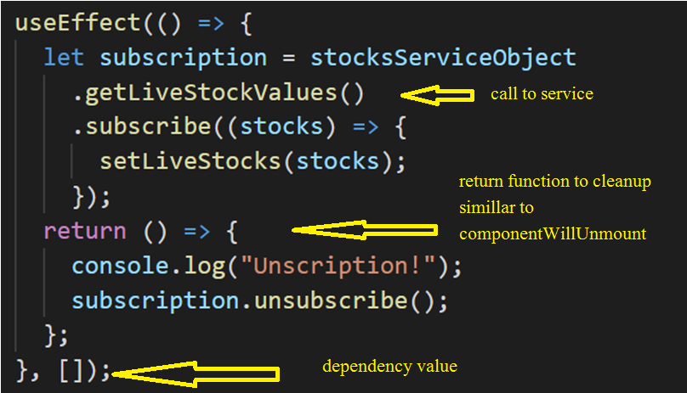
useEffect()
For Example –

Slide 13
Other Hooks
useContext()
useReducer()
useId() – React 18
useTransition() – React 18
useRef()
useMemo() – Will not be there in future versions of React
useCallBack() – Will not be there in future versions of React
Etc…

Slide 14
Rules
Do call hooks at the top level
Don’t call hooks inside loops, conditions or nested functions
Ensuring that Hooks are called in the same order each time a component renders
Only Call Hooks from React Functions
Don’t call hooks from regular JavaScript functions. Instead –
Call Hooks from React function components.
Call Hooks from custom Hooks
Ensuring that all stateful logic in a component is clearly visible from its source code

Slide 15
Router Hooks
useHistory() –
You access the history instance used by React Router
You can redirect users to another route/page using this instance
useParams() –
Used with dynamic routes
Access the current route parameter using this hook
useLocation() –
Returns the location object which represents the current URL and is immutable
Upon URL change, it returns newly updated location object along with query params and parameters

Slide 16
Router Hooks
useRouteMatch() –
Returns match object which contains all the information of the current URL matched with route path
It includes –
Params
isExact
Path
URL

